Slide 1


Task 3 Solution
Notes:
Hello, I’m Abdelrahman Abdelwahab. I’m here to explain my code, show my results, and how I got them.

Slide 2
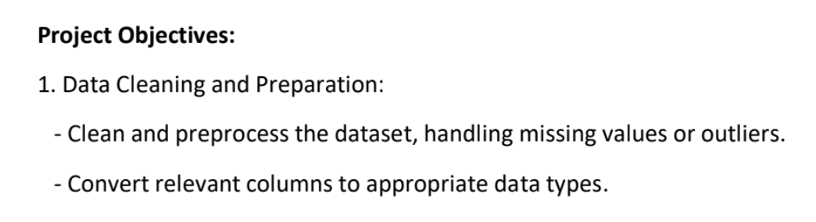
Notes:
In the third question we need to know What is the average price per room for reservations involving children
So I selected the coloumn of the prices and use the aggregate fn avg to get the average and use where clause to get only the one with the no_children > 0

Slide 3
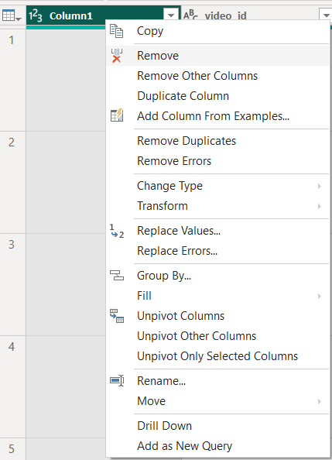
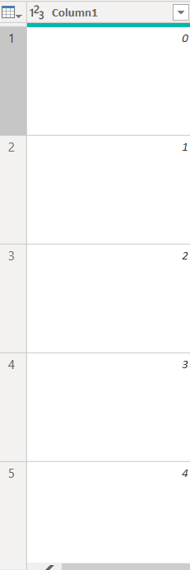
1
Task
Solution
Notes:
Unnecessary column, so I removed it.

Slide 4
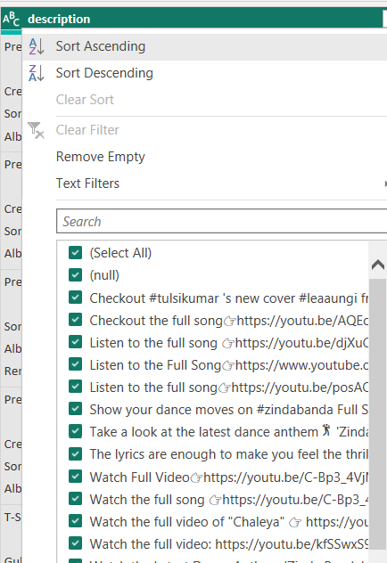
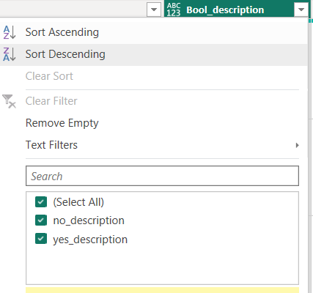
2
Task
Solution
Notes:
There where nulls. I did a conditional column, and during analysis I used it as a filter. So, I can analysis the data with and without the nulls. Also, if I removed the nulls’s rows that may lead to loosing valuable information.

Slide 5
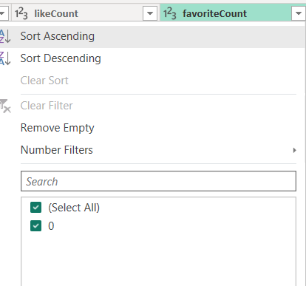
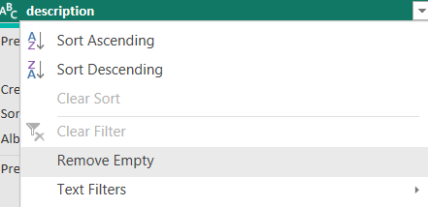
3
Task
Solution
Notes:
All records in this column was 0, so I removed it

Slide 6
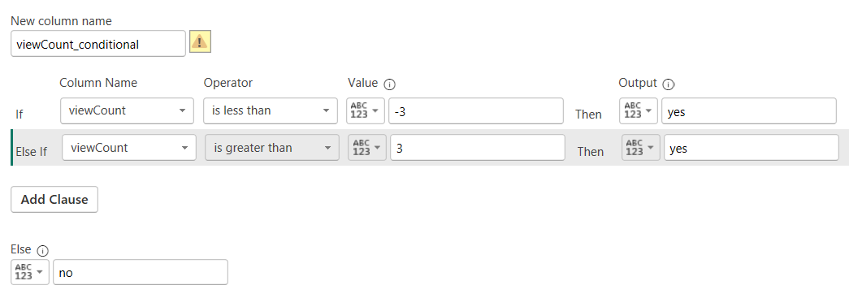
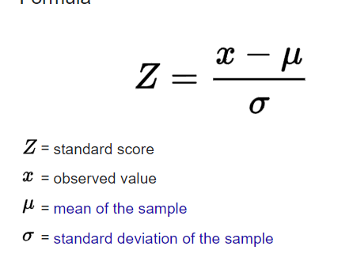
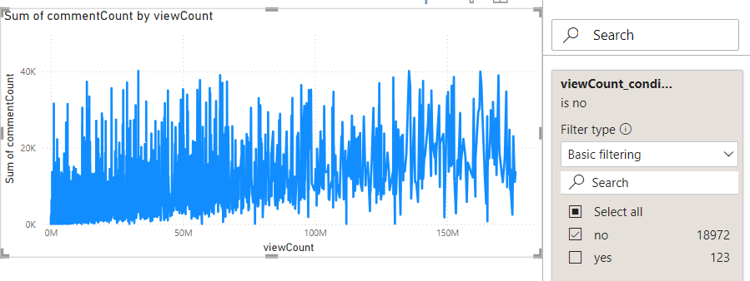
Solution
4
Task
Identifying and dealing with outliers
Notes:
I used the z score equation, then I did a conditional column to make yes on values less than -3 or greater than 3. Then, I used this column as a filter as shown in this example.
I used the same techniques for all columns with numerical values such as viewcount, like count, and comment count.

Slide 7
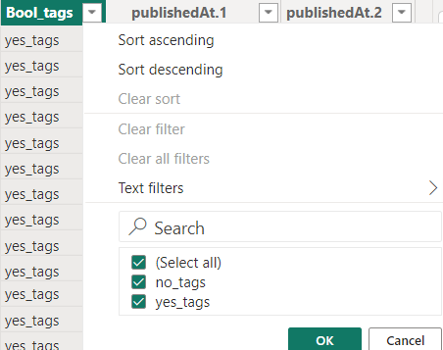
5
Task
Solution
Column “tags” had ‘[]’ which indicates that they are empty
Notes:
The column contained empty square brackets, so I did a conditional column to mark rows with tags with “yes_tage” and ones with empty [] with no_tags. Then I used the column in filter during the analysis

Slide 8
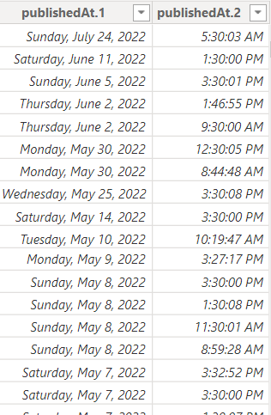
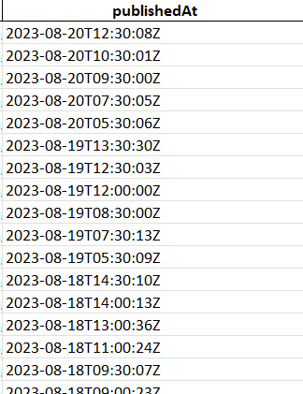
6
Task
Solution
Publication date
Notes:
All information about the time was in one column, so I splitted it into two columns as illustrated here to make to easier in visualization

Slide 9
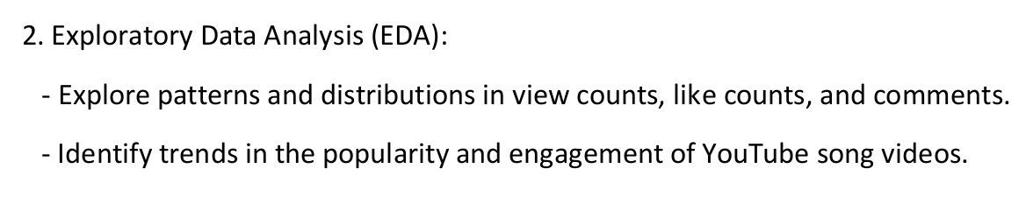

Slide 10
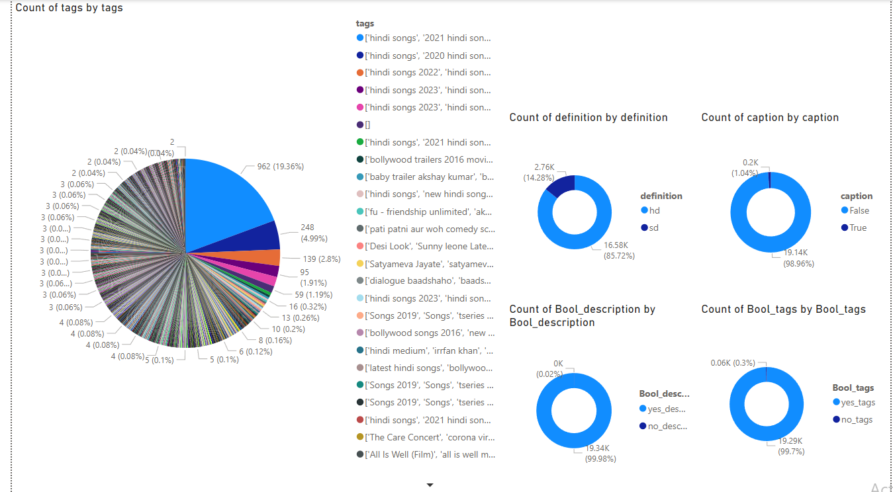
Notes:
This is a percentage slide to illustrates different categories values with the percentage of each record

Slide 11
Task
Explore patterns and distributions in view counts, like counts, and comment counts

Slide 12
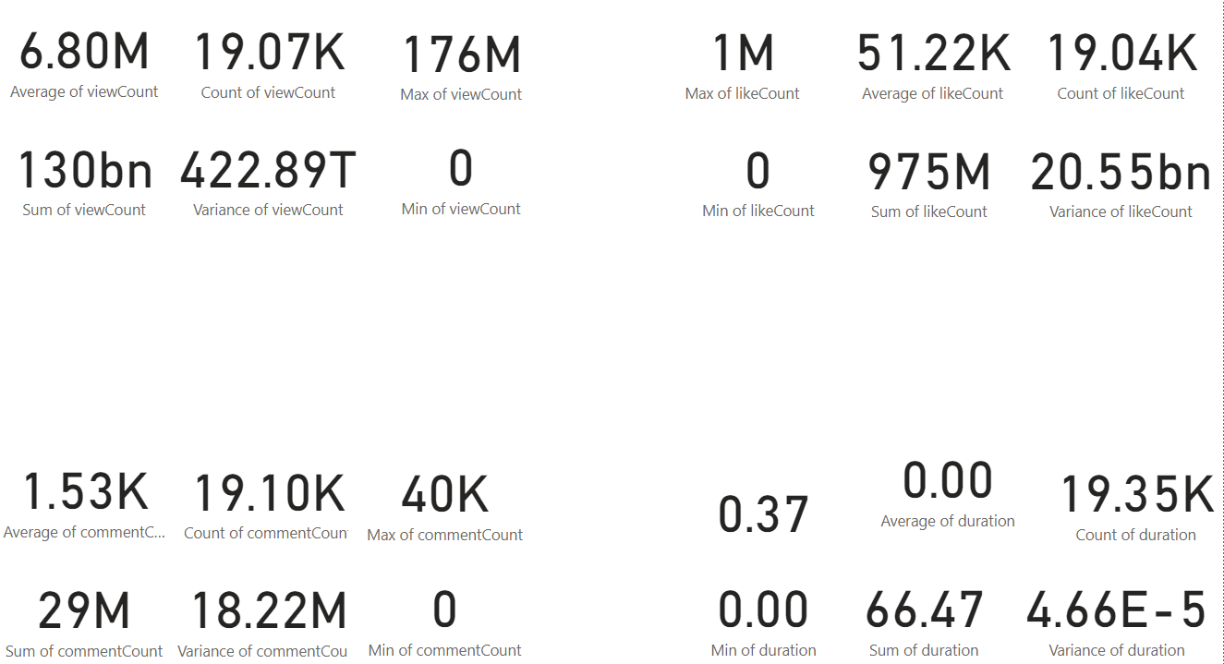
Notes:
This is a numerical analysis for viewcount, comment count, like count column that illustrates the average, sum, count, max, variance, and min of each of them.

Slide 13
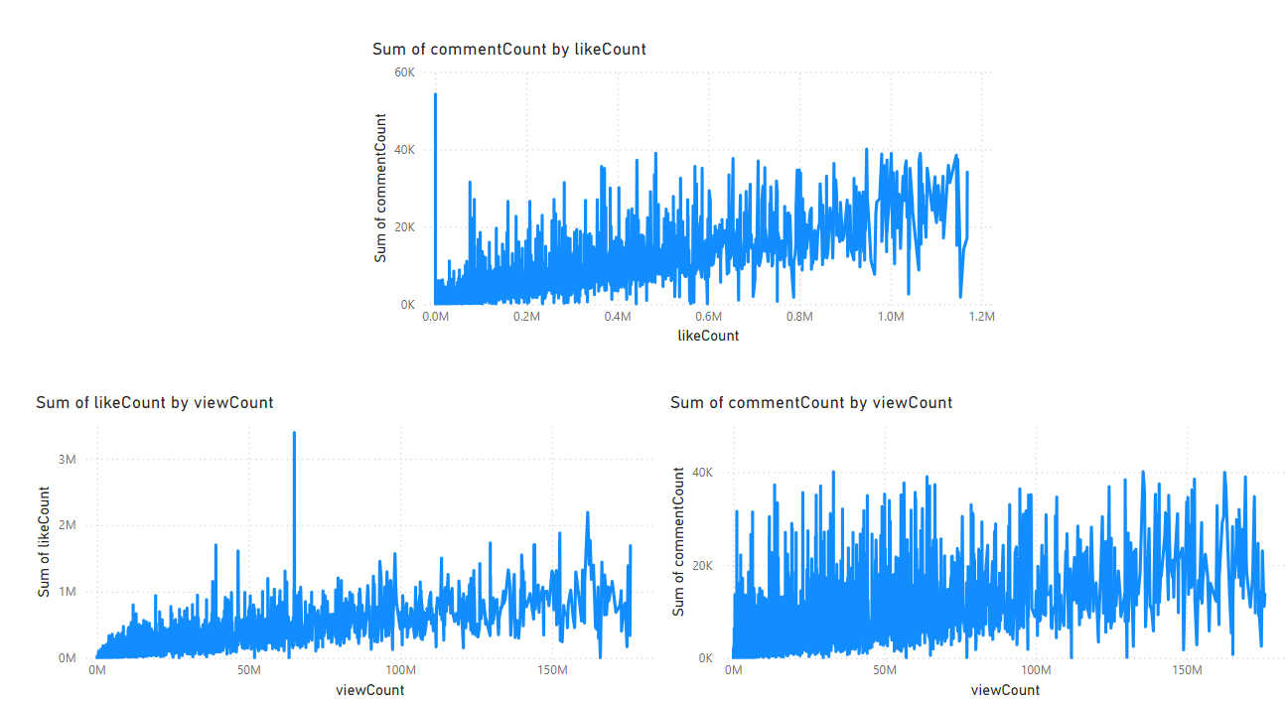
Notes:
This visualization is to illustrate the relation view, comment, and like
I did a graph for comment count vs like count, like count vs view count, and comment count vs view count. It seems there is no clear relation

Slide 14
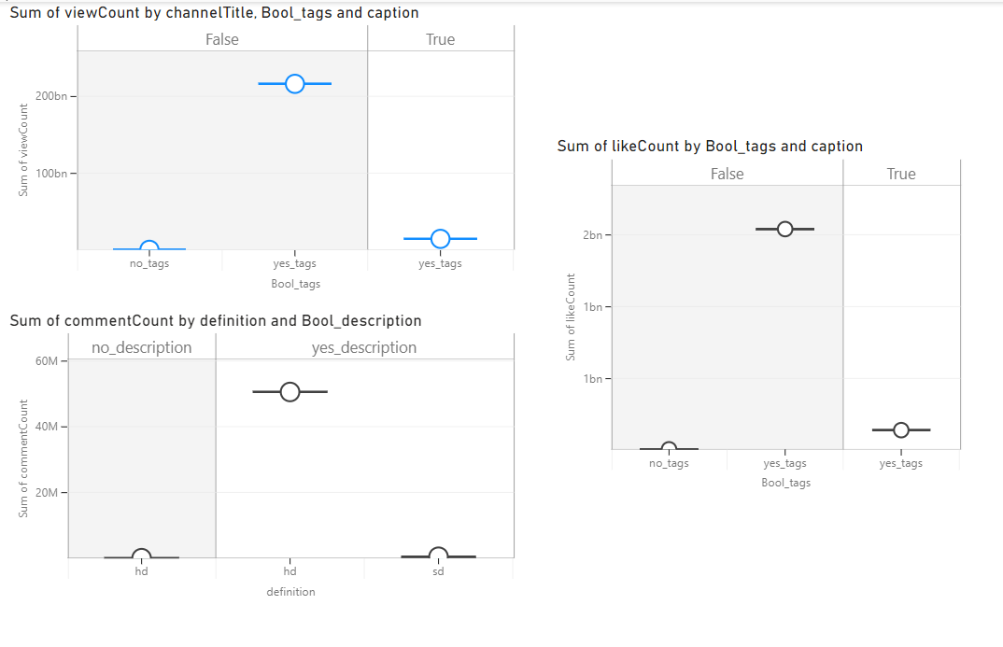
Notes:
This chart shows the view counts for videos with captions compared to those without captions, and also ones with tags and without tags. We can see that videos without captions have a higher sum of views compared to videos with captions. Specifically, videos without captions and have tags have total views greater than 200 billion. The same trend is observable for likes as shown in this figure.
The last graph shows the comment counts taking with description or not and definition type as a categorical values in visualization. It illustrates that the highest comments are for hd songs with description and the greatest comments number is more than 50 million

Slide 15
Task
Identify trends in the popularity and engagement of YouTube song videos

Slide 16
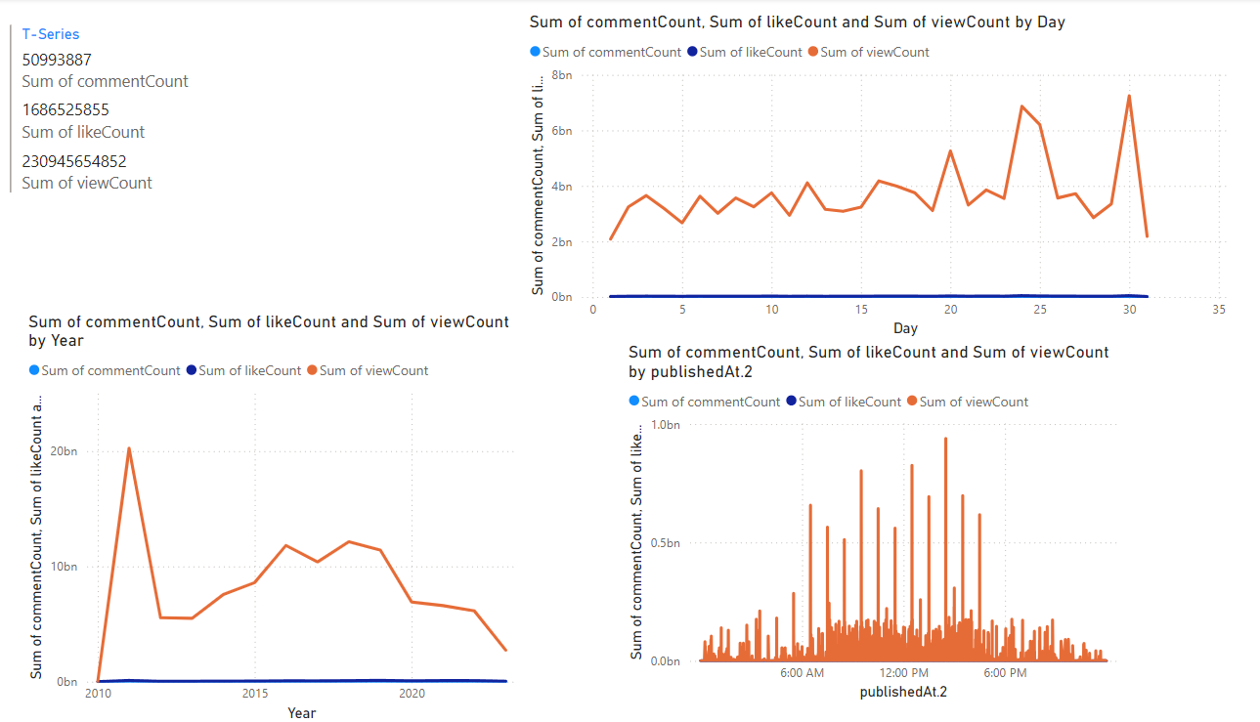
Notes:
I did this multi row card to help in identifying the popularity of each channel, but there was only one channel.
Also, I represented the views, comments, and likes versus different times such as years, days, and hours

Slide 17
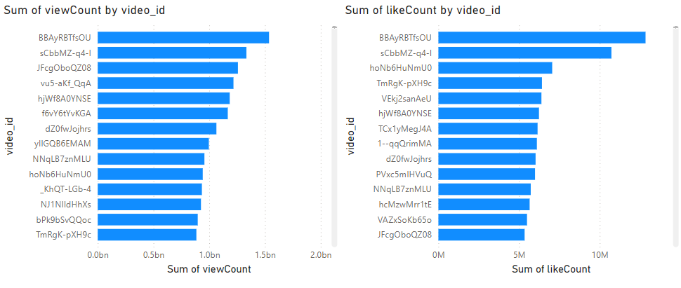
Notes:
Here is the number of likes and views for each song

Slide 18
Task
3. Content and Channel Analysis:
- Analyze the distribution of videos across different channels.
- Identify popular tags and their correlation with view counts.

Slide 19
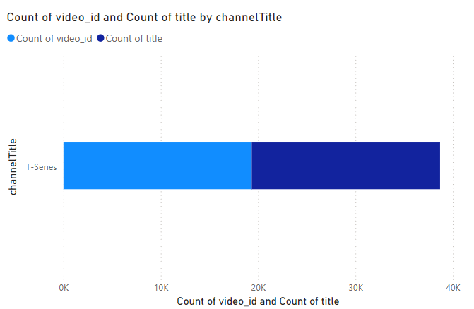
Notes:
This was to analyze the videos distribution across different channel, but as mentioned before there is only one channel in the data

Slide 20
Task
- Identify popular tags and their correlation with view counts.
Notes:
In the third question we need to know What is the average price per room for reservations involving children
So I selected the coloumn of the prices and use the aggregate fn avg to get the average and use where clause to get only the one with the no_children > 0

Slide 21
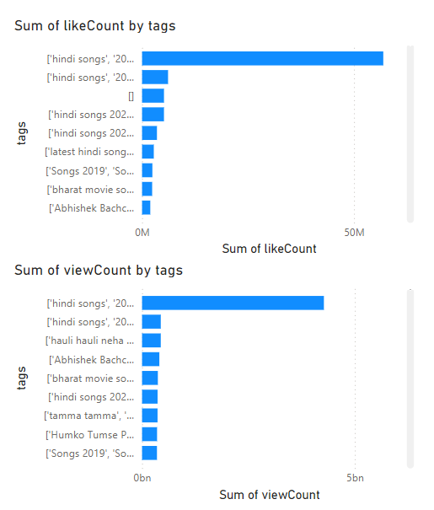
Notes:
From this pie chart, we can identify the popular tags. On the right hand side, I did a bar chart to show the like count and view count for tags

Slide 22
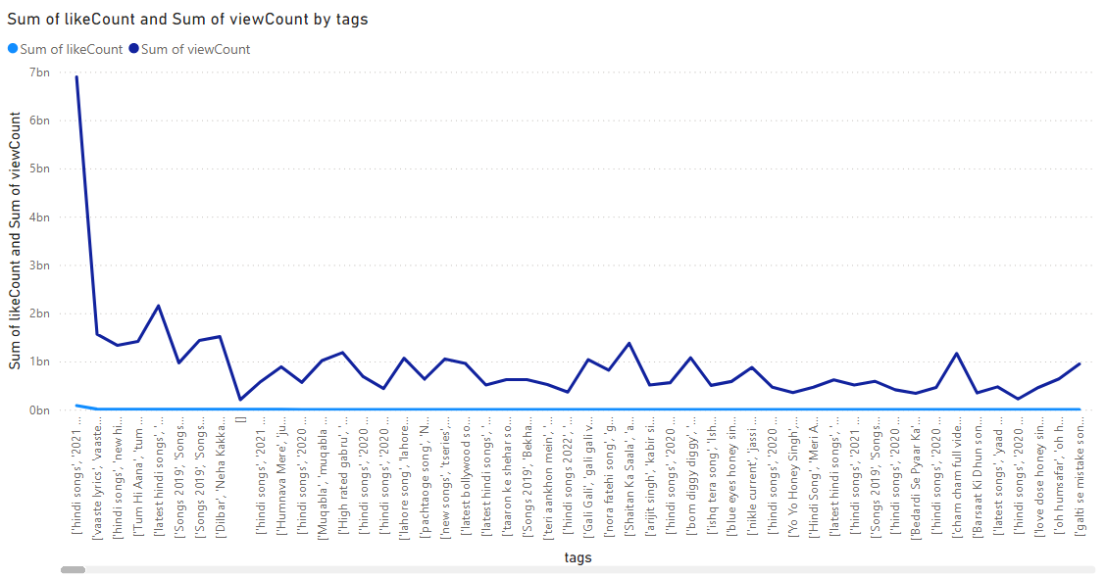
Notes:
This is also another type of visualization

Slide 23
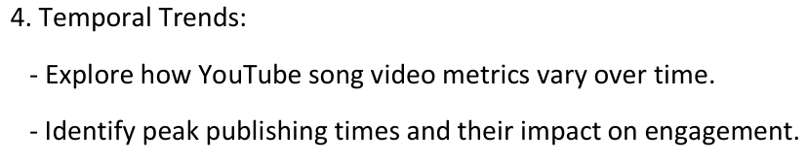

Slide 24
Notes:
This graphs as illustrated before represent the views, comments, and likes versus different times such as years, days, and hours

Slide 26
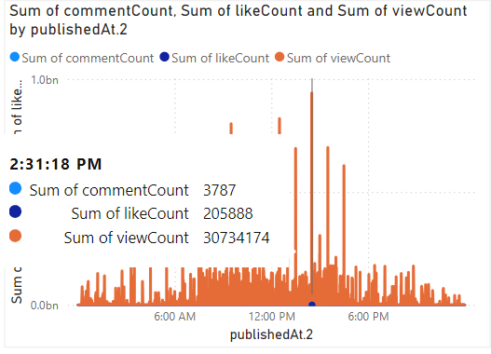
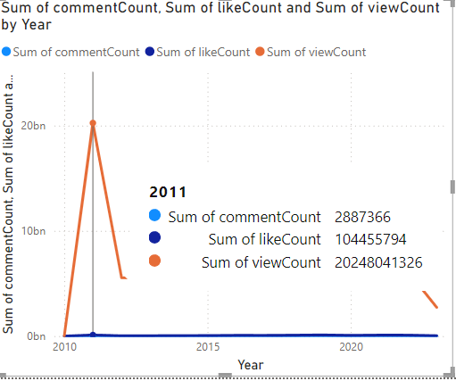
Notes:
For hours, the publishing peak was 2:31 pm.
For years, the publishing peak was 2011 pm.
From the figures, we can deduce the max comment count, view count, and like count.

Slide 27
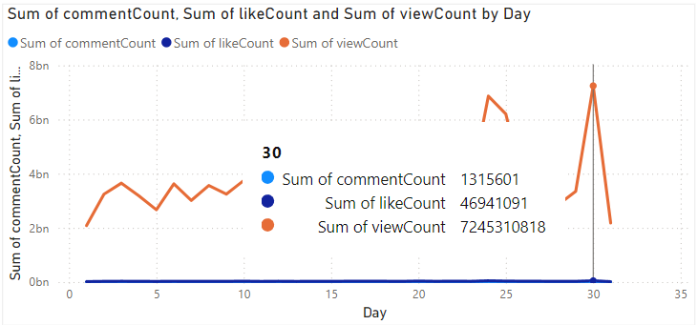
Notes:
For days, the publishing peak was 30.
From the figures, we can deduce the max comment count, view count, and like count.

Slide 28
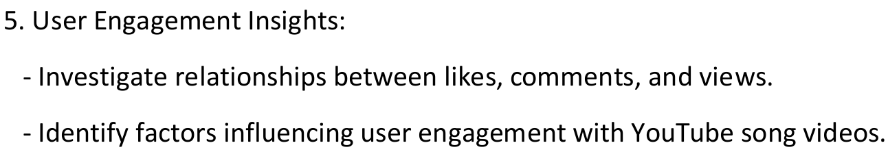

Slide 29
Notes:
I visualized comment vs like, view vs like, and view vs comment, but it seems there is no clear relation

Slide 31
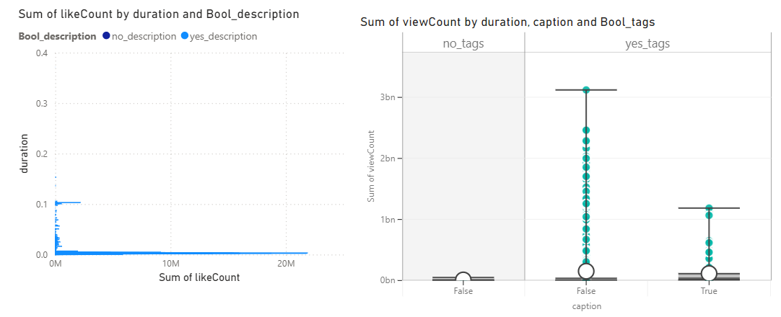
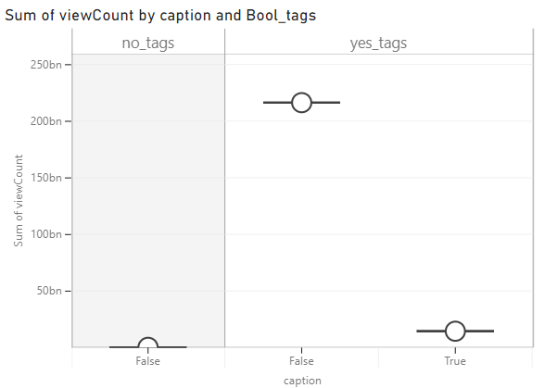
Notes:
the graph on the left hand side shows that videos with descript and low duration tend to have high likes
The graph on the right shows that videos with tags and without caption tend to have high views

Slide 32
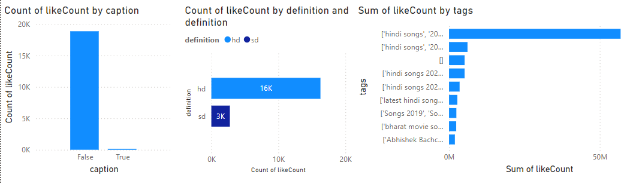
Notes:
The two graphs at the right ensure the trends discussed in the previous slide
The new is the graph at left. It shows that hd videos hve more likes

Slide 33
Use hd videos
Don’t use caption
Use description
Low duration
Use tags

